Slide 1
Integration Testing with Maven and DB Unit
Victor Grazi – NY Coach
Frank Booth – London Coach

Slide 2
Purpose of Integration Test
Integration testing provides assurances of interactions at our “zone of influence” - where we negotiate with other teams. They test our mocked objects and stubs.
Integration tests ensure code is:
functional
reliable.
Prove out the bindings to:
low-level subsystems
larger systems
Our NFRs (non-functional requirements are often attested in integration testing)

Slide 3
Types of Integration Test
Big Bang – Everything is brought together at the end of the project to test
Bottom-Up – Integration is made close to the reality of the problem-space.
Top Down – Integration of larger systems
Pros | Cons
Costs can be postponed. | Risk is retained until late in the project.
Pros | Cons
Risk is eliminated earlier. Certainty increased. | Costs for hardware are made sooner.
Pros | Cons
Tests actual business cases | Complexity of tests is higher Occurs later in SDLC

Slide 4


Integration Tests Pick Up where Unit Tests Leave Off

Slide 5
Unit Testing vs. Integration Testing
 | Unit Tests |  | Integration Tests
Requirement | Test single units in isolation |  | Test interactions between software components in-vivo
Maven plugin | Surefire plugin |  | Failsafe plugin
Maven phase | test |  | verify
To skip | --skipTests |  | --skipITs
Default class name | Test*, *Test, *Tests, *TestCase.java |  | IT*, *IT, *ITCase.java
Default source dir | ${project.build.testSourceDirectory}/
Default output report | target/
 | surefire-reports/TEST-<classname>.xml |  | failsafe-reports/failsafe-summary.xml

Slide 6
Maven Integration Test Phases
Maven lifecycle has four phases for running integration tests:
pre-integration-test – sets up integration test environment.
integration-test – runs the integration tests.
post-integration-test – tears down integration test environment.
verify – checks the results of the integration tests.
Failsafe Plugin will not fail the build during the integration-test phase, allowing post-integration-test phase to execute.
That’s why it’s called “Fail-Safe!”
(Surefire Plugin will stop the build at the integration-test phase and integration test environment will not be torn down correctly.)

Slide 7
Operation
DBUnit is a Junit extension.
Especially useful for Integration testing:
Installs data in database
Runs your code
Executes SQL
Asserts the results
Tears down the data
All during mvn verify phase
Great with Cucumber!

Slide 8
Best practices
Use one dedicated database for testing
A good test set starts with a replica of production schema
And creates all of the data it needs
But no more than that
Tests should not depend on results of other tests
Tests should be idempotent – can run over and over

Slide 9
Maven Dependency
<dependency>
<groupId>org.dbunit</groupId>
<artifactId>dbunit</artifactId>
<version>2.5.4</version>
</dependency>

Slide 10
Failsafe Plugin
<plugin>
<groupId>org.springframework.boot</groupId>
<artifactId>spring-boot-maven-plugin</artifactId>
<executions>
<execution>
<id>pre-integration-test</id>
<goals>
<goal>start</goal>
</goals>
</execution>
<execution>
<id>post-integration-test</id>
<goals>
<goal>stop</goal>
</goals>
</execution>
</executions>
</plugin>
Start Tomcat
StopTomcat

Slide 11
Lifecycle methods
abstract DataBaseTestCase extends junit.framework.TestCase
protected abstract IDatabaseConnection getConnection() throws Exception;
protected abstract IDataSet getDataSet() throws Exception;
protected void setUp() throws Exception {
logger.debug("setUp() - start");
super.setUp();
IDatabaseTester databaseTester = this.getDatabaseTester();
assertNotNull("DatabaseTester is not set", databaseTester);
// Default set up operation does a “delete all” followed by an “insert”
databaseTester.setSetUpOperation(this.getSetUpOperation());
databaseTester.setDataSet(this.getDataSet());
databaseTester.setOperationListener(this.getOperationListener());
databaseTester.onSetup();
}

Slide 12
Data Set
<?xml version="1.0" encoding="UTF-8"?>
<dataset>
<USER userid='1' first_name=Victor' last_name=‘Grazi' />
<USER userid='2' first_name=‘Frank' last_name=‘Booth' />
<USER userid='3' first_name=‘Slavomir' last_name=‘Kundrik' />
</dataset>
* Place this under the resources root

Slide 13
Lifecycle methods
abstract DataBaseTestCase extends junit.framework.TestCase
protected void tearDown() throws Exception {
logger.debug("tearDown() - start");
try {
IDatabaseTester databaseTester = getDatabaseTester();
assertNotNull( "DatabaseTester is not set", databaseTester );
databaseTester.setTearDownOperation( getTearDownOperation() );
databaseTester.setDataSet( getDataSet() );
databaseTester.setOperationListener(getOperationListener());
databaseTester.onTearDown();
} finally {
tester = null; super.tearDown();
}
}

Slide 14
SetUp and TearDown Operations
protected void tearDown() throws Exception {
logger.debug("tearDown() - start");
try {
IDatabaseTester databaseTester = getDatabaseTester();
assertNotNull( "DatabaseTester is not set", databaseTester );
databaseTester.setTearDownOperation( getTearDownOperation() );
databaseTester.setDataSet( getDataSet() );
databaseTester.setOperationListener(getOperationListener());
databaseTester.onTearDown();
} finally {
tester = null; super.tearDown();
}
}

Slide 15
DatabaseOperation Static Fields
UPDATE | Updates database from the dataset contents. Assumes table data already exists in the target database
INSERT | Inserts dataset contents into database. Assumes table data does not exist in the target database.
DELETE | Deletes only the dataset contents from the database. Does not delete the entire table contents.
DELETE_ALL | Deletes all rows of tables present in the specified dataset. Table are truncated in reverse sequence.
TRUNCATE_TABLE | Truncate tables present in the specified dataset. Table are truncated in reverse sequence.
REFRESH | Data of existing rows are updated or inserted.
CLEAN_INSERT | This composite operation performs a DELETE_ALL operation followed by an INSERT operation.
NONE | Empty operation that does absolutely nothing.

Slide 16
Additional DatabaseOperations
CompositeOperation | Combines multiple operations into a single one.
TransactionOperation | Decorates an operation and executes it within the context of a transaction.
InsertIdentityOperation | Decorates an insert operation and disables the MS SQL Server automatic identifier generation (IDENTITY) during its execution. Use following constants: InsertIdentityOperation.INSERT InsertIdentityOperation.CLEAN_INSERT or InsertIdentityOperation.REFRESH instead of those defined in DatabaseOperation.

Slide 17
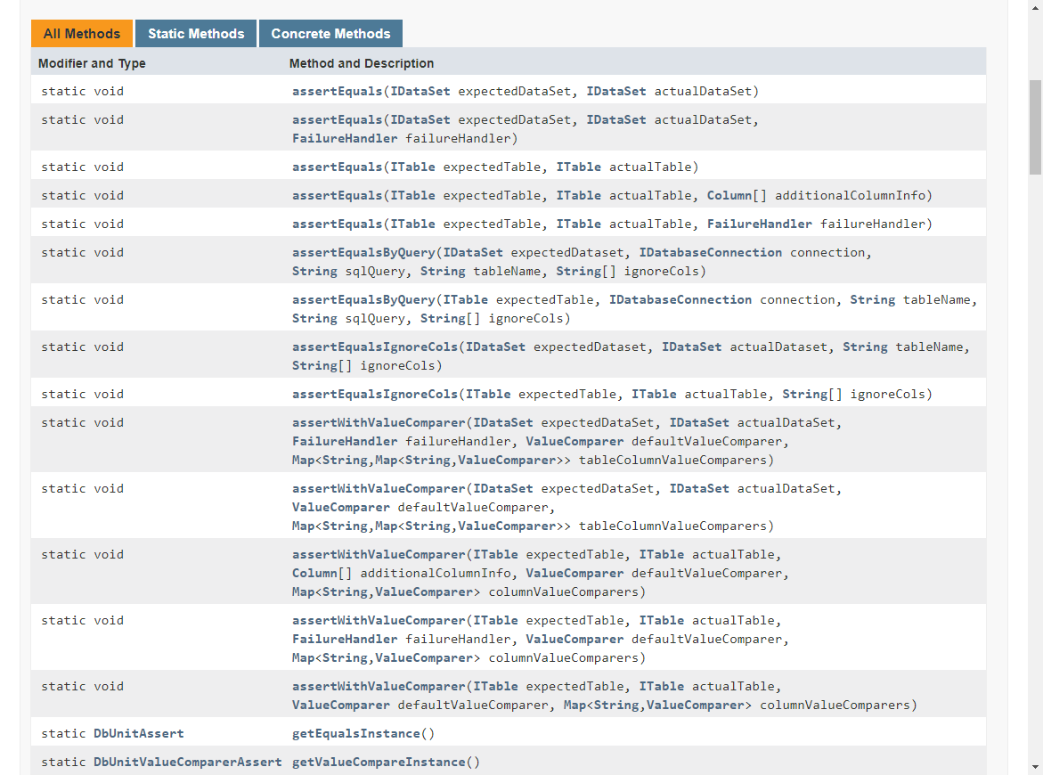
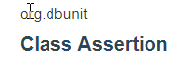
DatabaseOperation Static Fields

Slide 18
Assertion class
http://dbunit.sourceforge.net/components.html
http://dbunit.sourceforge.net/testcases/PrepAndExpectedTestCase.html
http://dbunit.sourceforge.net/components.html#dataset

Slide 19
Q&A

